Slide 1
AWS Lambda Metrics Demo
Release 15-2023.01.31

Slide 2
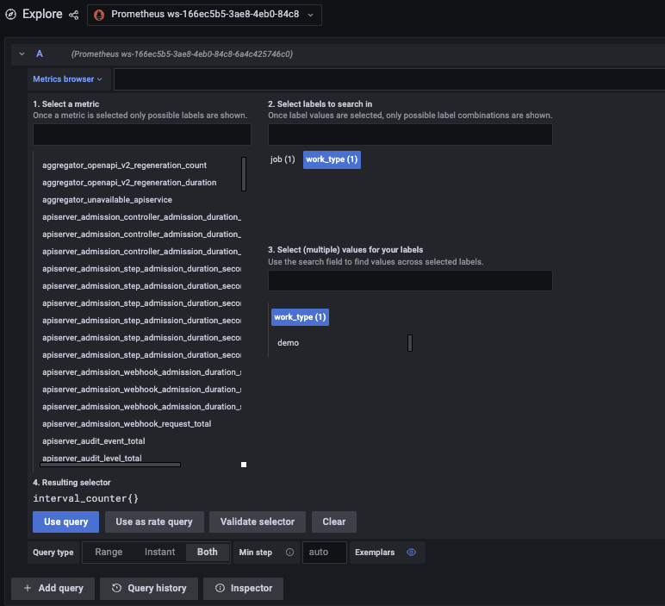
Local Run with Port-Forward
from opentelemetry import metrics
from opentelemetry.exporter.otlp.proto.grpc.metric_exporter import OTLPMetricExporter
from opentelemetry.sdk.metrics import MeterProvider
from opentelemetry.metrics import set_meter_provider
from opentelemetry.sdk.metrics.export import PeriodicExportingMetricReader
def handler(event, context):
exporter = OTLPMetricExporter(endpoint="http://localhost:4317")
reader = PeriodicExportingMetricReader(exporter, export_interval_millis=100)
provider = MeterProvider(metric_readers=[reader])
set_meter_provider(provider)
meter = metrics.get_meter(__name__)
metric_interval_counter = meter.create_counter("interval.counter", unit="1", description="Counts the number of intervals processed")
metric_interval_counter.add(1, {"work.type": "demo"})
handler(0, 0)

Slide 3
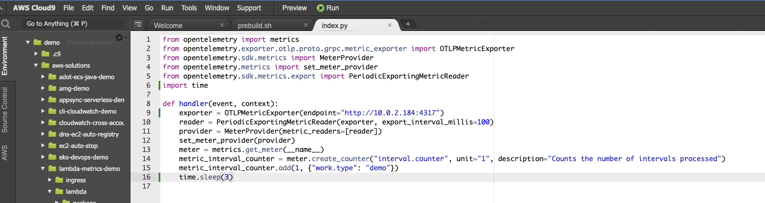
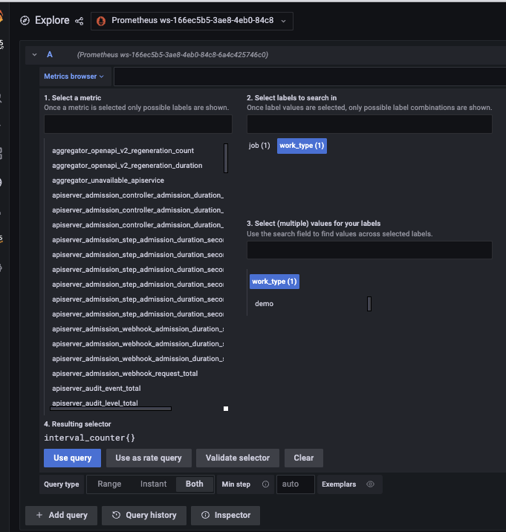
Remote Run with Pod IP
Some Tweaks:
Remove local function call “handler(0, 0)”
Add Sleep as emit function is async call
Use Pod IP

Slide 4
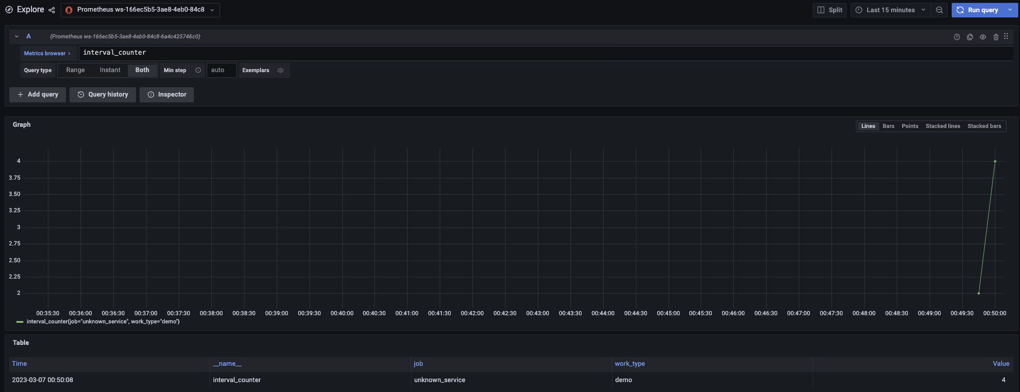
Remote Run with Internal Service
apiVersion: v1
kind: Service
metadata:
name: lambda-metrics-collector
namespace: observability
annotations:
service.beta.kubernetes.io/aws-load-balancer-type: external
service.beta.kubernetes.io/aws-load-balancer-nlb-target-type: ip
service.beta.kubernetes.io/aws-load-balancer-scheme: internal
spec:
ports:
- port: 4317
targetPort: 4317
protocol: TCP
type: LoadBalancer
selector:
app.kubernetes.io/name: metrics-lambda-collector-collector

